Slide 1
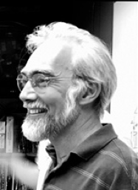
Fraud in Imaging The Most Important Lecture you will ever get!!
Prof. J. Paul Robinson
The SVM Professor of Cytomics
College of Veterinary Medicine
Professor of Biomedical Engineering
College of Engineering
These slides are intended for use in a lecture series. Copies of the graphics are distributed and students encouraged to take their notes on these graphics. All material copyright J. Paul Robinson unless otherwise stated, however, the material may be freely used for lectures, tutorials and workshops for not-for-profit institutions. It may not be used for any commercial purpose and may not be uploaded to CourseHero or any other similar operation.
www.cyto.purdue.edu
UPDATED March 2021

Slide 2
Learning Objectives
Reality:
Fraud exists in every field of endeavor – business, sport, art, science & medicine
Learn what constitutes a fraudulent image?
Understand what can you do legally to manipulate an image?
Be clear on the consequences of manipulating images fraudulently?
Know the rules of image manipulation because ignorance is not a defense!
Use programs like Photoshop with caution on scientific images
If you suspect fraud, the bottom line is you are obligated to report it
Understand that there is a lifelong impact if you cheat in your science – particularly in image manipulation.

Slide 3
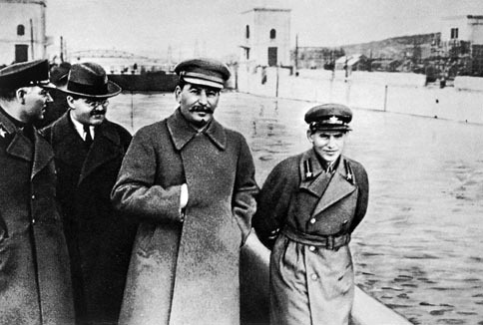
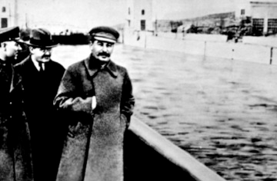
Joseph Stalin made use of photo retouching for propaganda purposes.^{[4]} On May 5, 1920 his predecessor Vladimir Lenin held a speech for Soviet troops that Leon Trotsky attended. Stalin had Trotsky retouched out of a photograph showing Trotsky in attendance. Nikolai Yezhov, an NKVD leader photographed alongside Stalin in at least one photograph, was edited out of the photograph after his execution in 1940. For more information, see images altered by Soviet censors.
http://en.wikipedia.org/wiki/Photo_manipulation

Slide 4
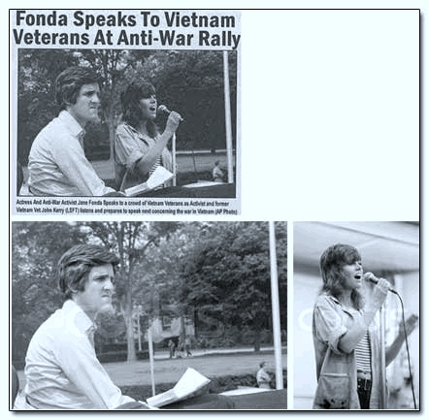
Faked images in the media
Fake image circulated during the 2004 Federal Election
It was a case of Photoshop fraud
How was it found out? The original photographer of the Kerry Image (Ken Light) recognized the fake and reported it
As often happens in politics there were no real consequences but there are in science!!
http://urbanlegends.about.com/library/bl_kerry_fonda.htm

Slide 5
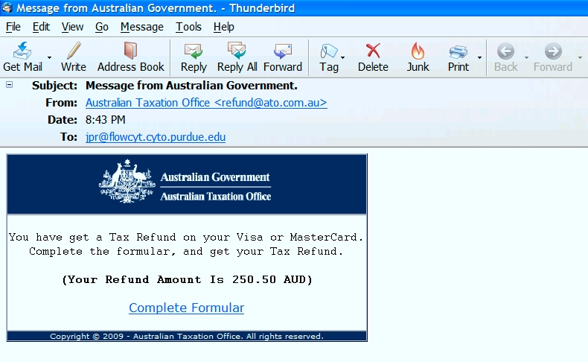
When you cheat, there are often tell-tale signs…..
Site as it was in 2009
Site as it is today 2017

Slide 6
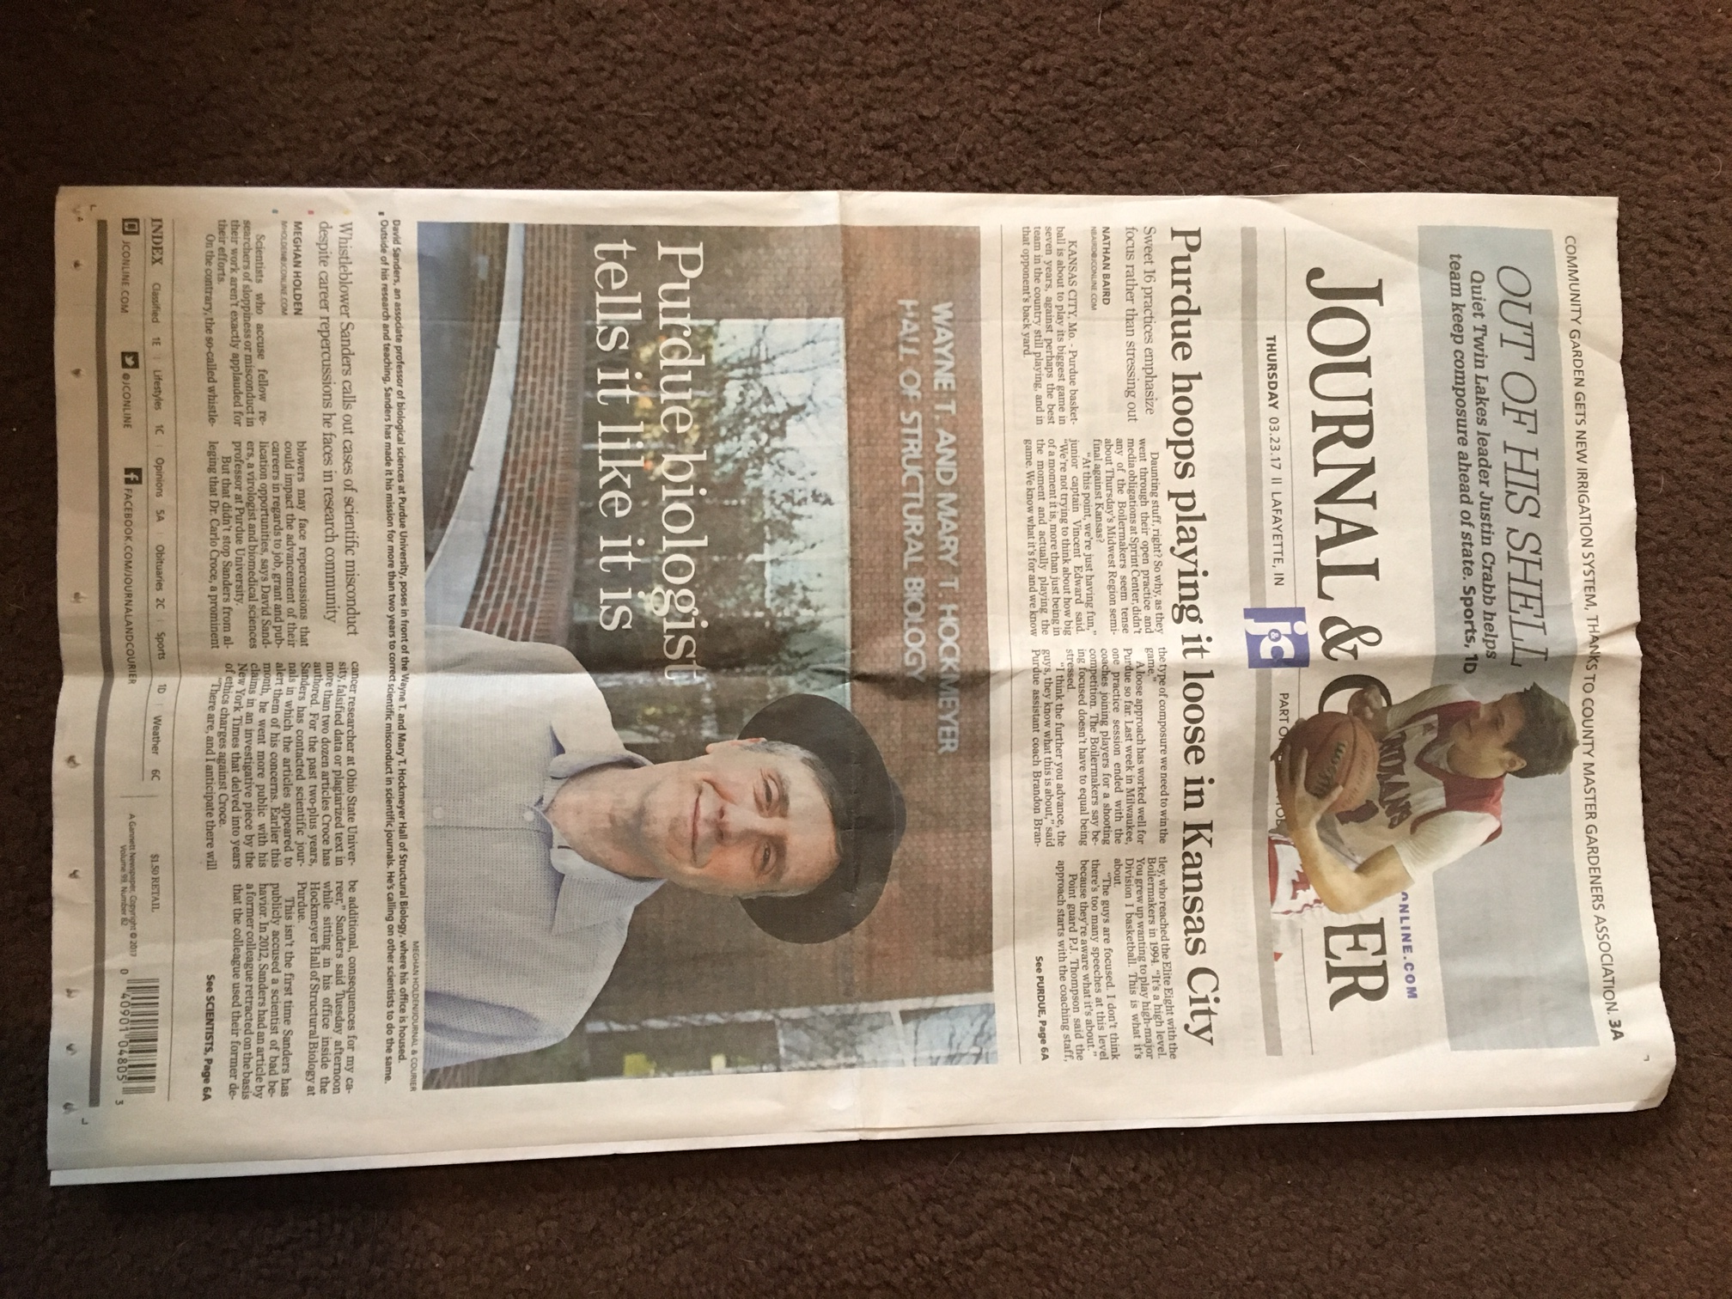
What is so different today?
J&C article by Meghan Holden
23 March, 2017
Photoshop …..
….and many other image manipulation packages.

Slide 7
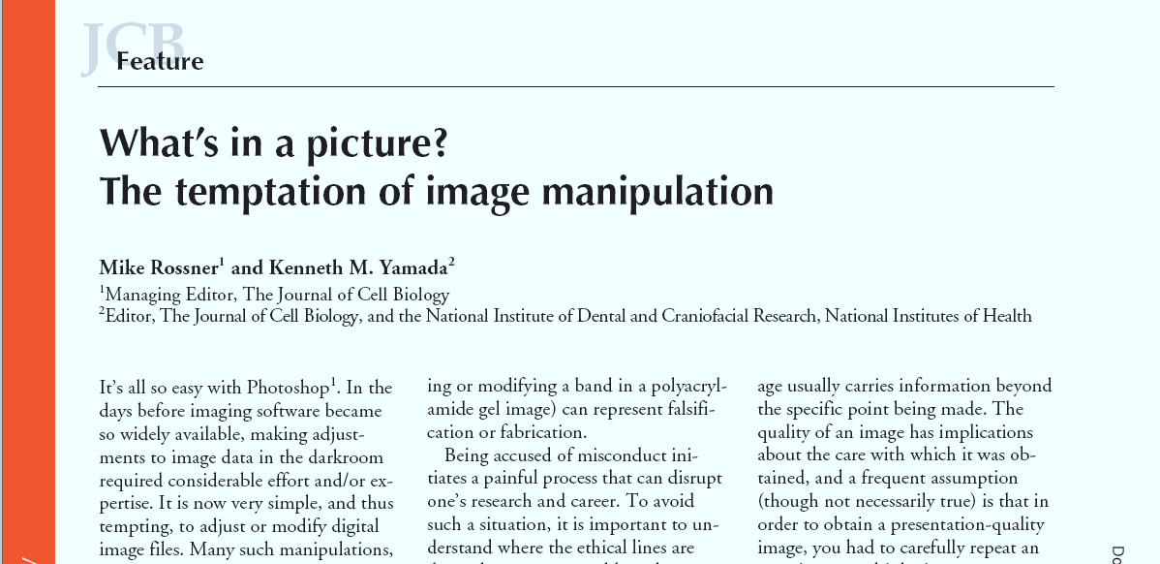
Manipulating Scientific Images
Ref: The Journal of Cell Biology Volume 166, Number 1, 2004

Slide 8
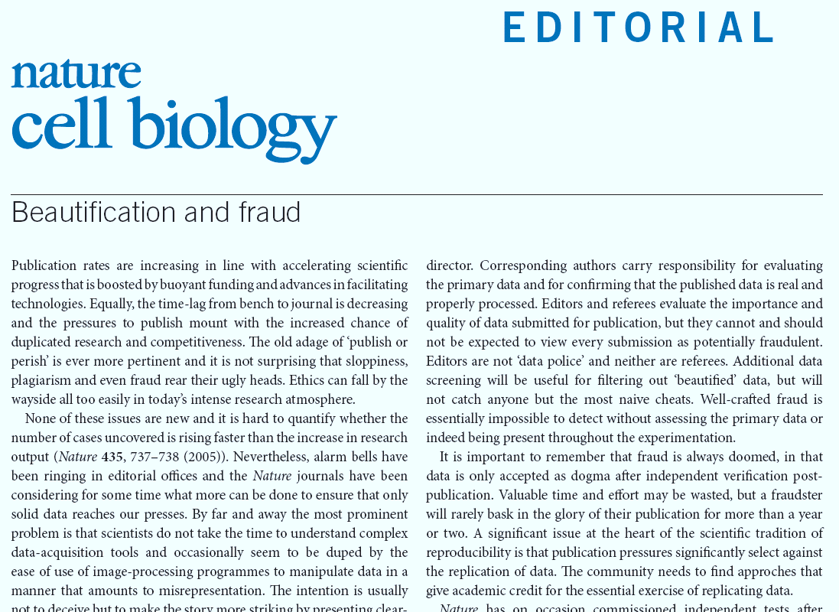
NATURE CELL BIOLOGY VOLUME 8 | NUMBER 2 | FEBRUARY 2006
“It is important to remember that fraud is always doomed..”

Slide 9
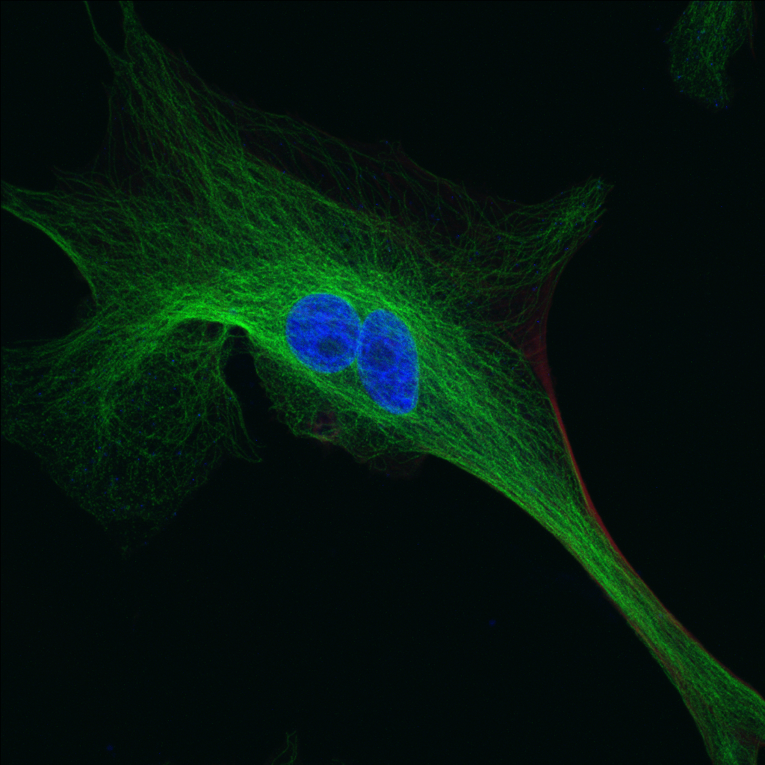
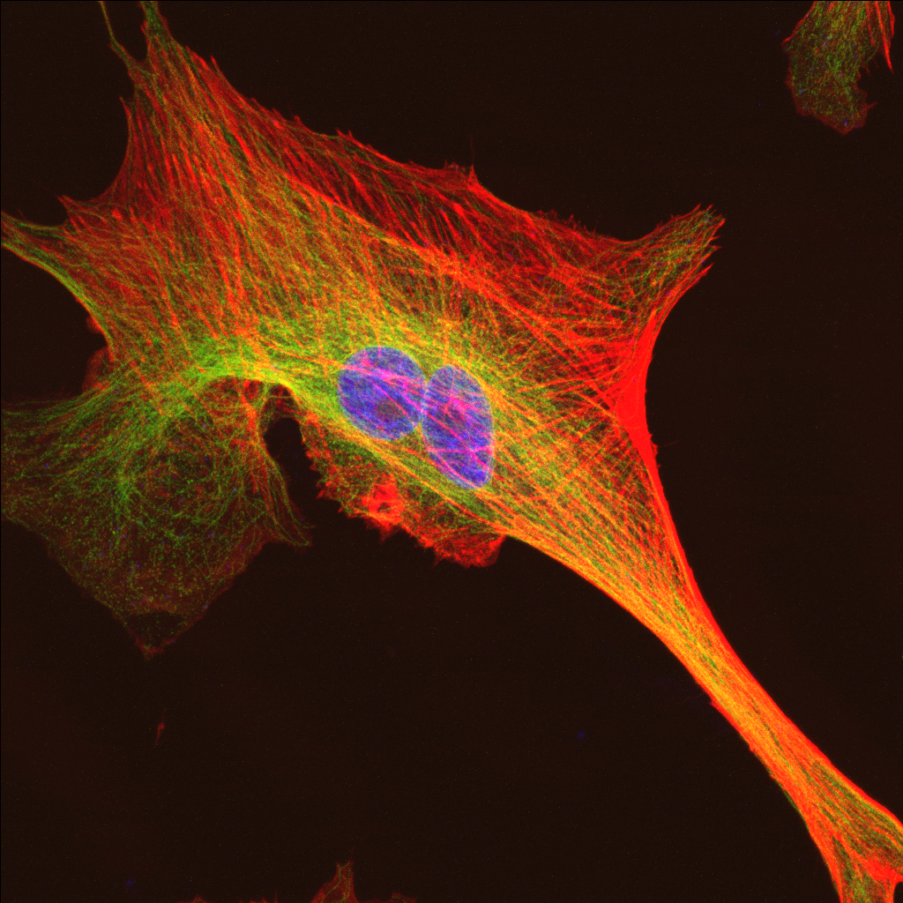
Enhancing images – or not!
Image collected by Jennie Sturgis at PUCL using a Biorad 2P system
Since multicolor images are composed of multiple monochrome layers you can show some layers or not! But you cannot intentionally NOT show one color if it suits your hypothesis!!

Slide 10
Enhancing images – or not!
Images collected by Jennie Sturgis at PUCL using a Biorad 2P system
Since multicolor images are composed of multiple monochrome layers you can show some layers or not! But you cannot intentionally NOT show one color if it suits your hypothesis!!

Slide 11
The Rules of Image Publishing
The Journal of Cell Biology
.
“No specific feature within an image may be
enhanced, obscured, moved, removed,
or introduced. The grouping of images
from different parts of the same gel, or
from different gels, fields, or exposures
must be made explicit by the arrangement
of the figure (e.g., using dividing
lines) and in the text of the figure legend.
Adjustments of brightness, contrast,
or color balance are acceptable if
they are applied to the whole image
and as long as they do not obscure or
eliminate any information present in
the original. Nonlinear adjustments
(e.g., changes to gamma settings) must
be disclosed in the figure legend.”
When you ignore these rules you have cross the line of acceptable manipulation of images in science
Ref: The Journal of Cell Biology Volume 166, Number 1, 2004

Slide 12
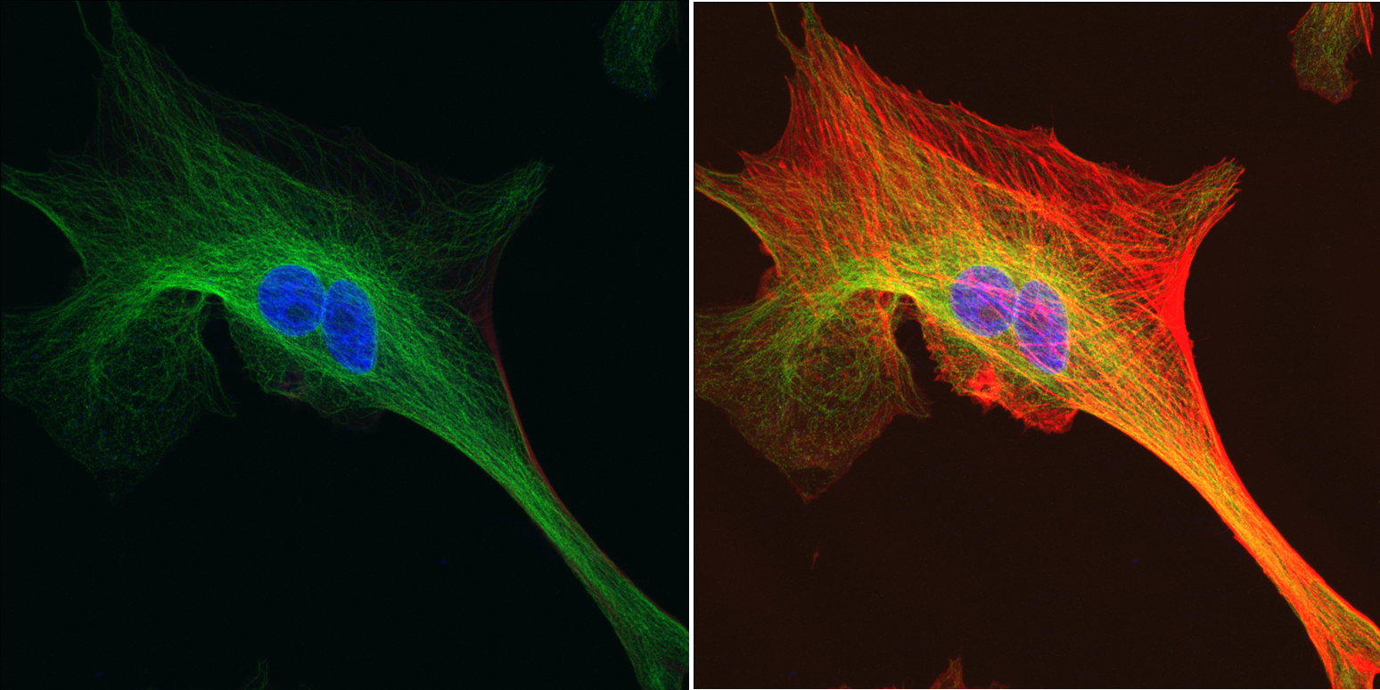
First rule
“No specific feature within an image may be enhanced, obscured, moved, removed,
or introduced”

Slide 13
2nd Rule
The grouping of images from different parts of the same gel, or from different gels, fields, or exposures must be made explicit by the arrangement of the figure (e.g., using dividing
lines) and in the text of the figure legend.

Slide 14
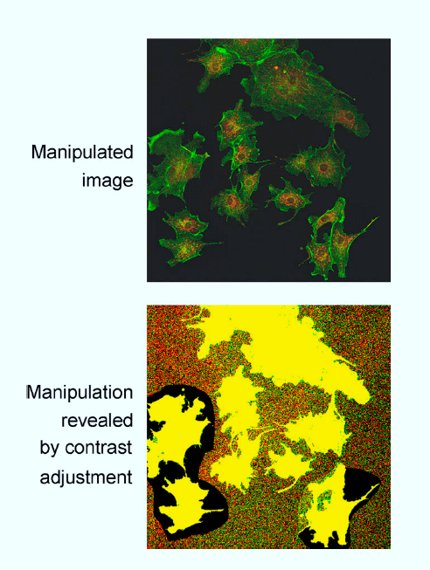
Figure 6. Misrepresentation of image data.
Cells from various fields have been juxtaposed in a single image, giving the impression that they were present in the same microscope
field. A manipulated panel is
shown at the top. The same panel, with the contrast adjusted by us to reveal the manipulation, is shown at the bottom.
Retracted Paper:
Author charged with Fraud
Ref: The Journal of Cell Biology Volume 166, Number 1, 2004

Slide 15
3rd rule
Adjustments of brightness, contrast, or color balance are acceptable if they are applied to the whole image and as long as they do not obscure or eliminate any information present in the original.
BUT –
don’t change the controls differently to experimental images….

Slide 16
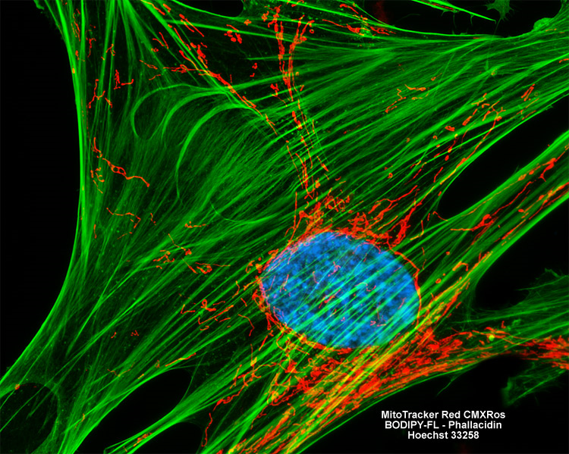
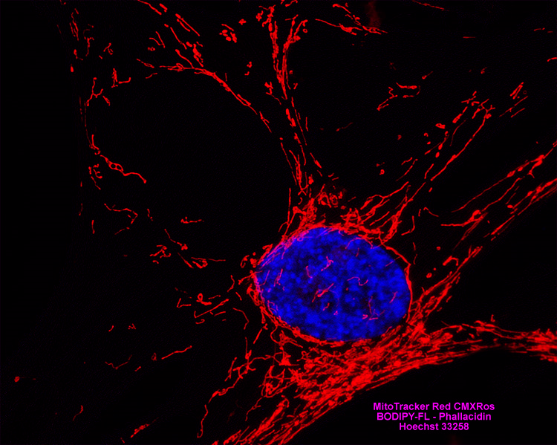
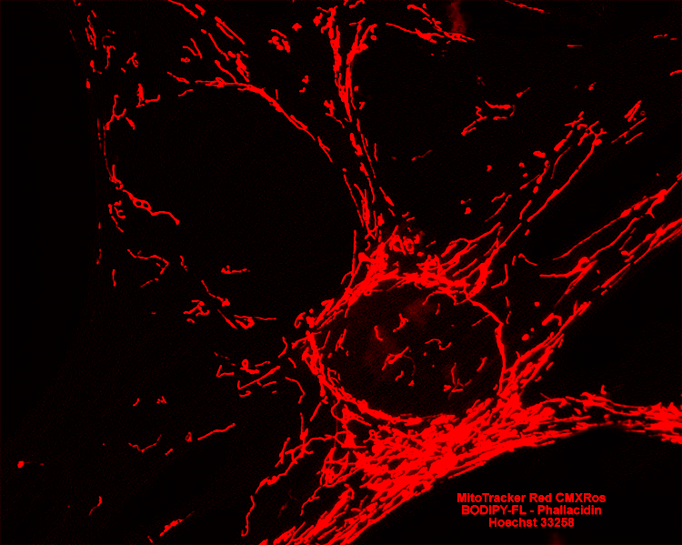
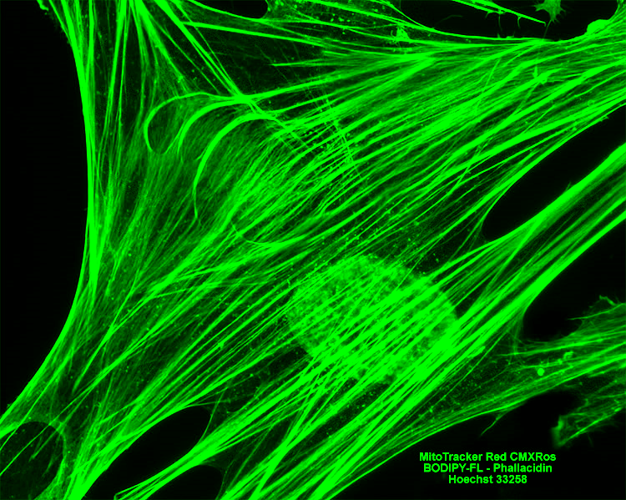
Manipulated Images

Slide 17
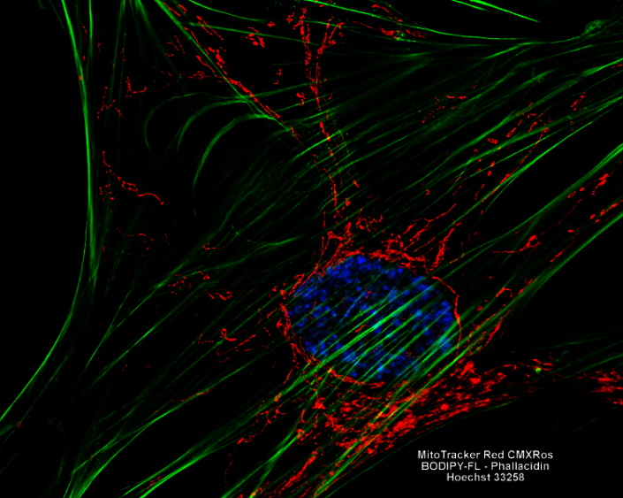
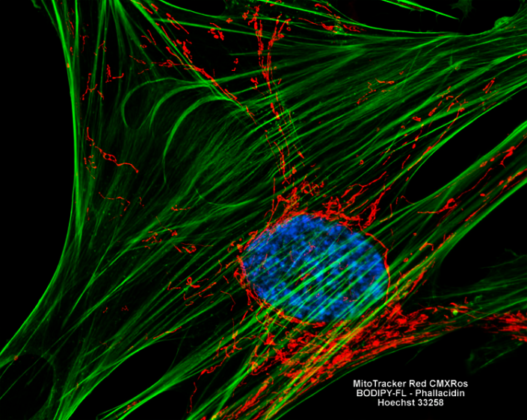
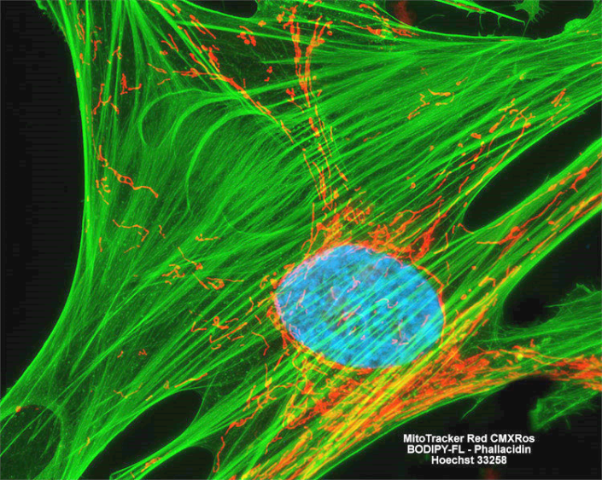
4th Rule
Nonlinear adjustments (e.g., changes to gamma settings) must be disclosed in the figure legend.”
Gama has been changed to change the “level” of green intensity
But if you do this to obscure or reduce the apparent presence of one component, this is fraud

Slide 18
Cleaning up background
“It is very tempting to use the tool variously known as “Rubber Stamp” or “Clone Stamp” in Photoshop to clean up unwanted background in an image. Don’t do it. This kind of manipulation can usually be detected by someone looking carefully at the image file because it leaves telltale signs. Moreover, what may seem to be a background band or contamination may actually be real and biologically important and could be recognized as such by another scientist.”
Photoshop is NOT an acceptable image manipulation tool for scientific images
Ref: The Journal of Cell Biology Volume 166, Number 1, 2004

Slide 19
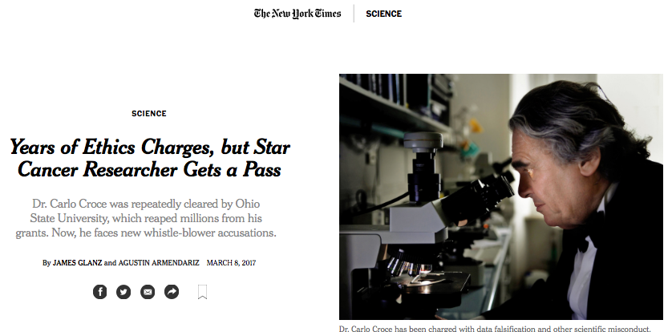
Fraud can be anywhere
Identified by one
of our Purdue Faculty
Dr. David Sanders

Slide 20
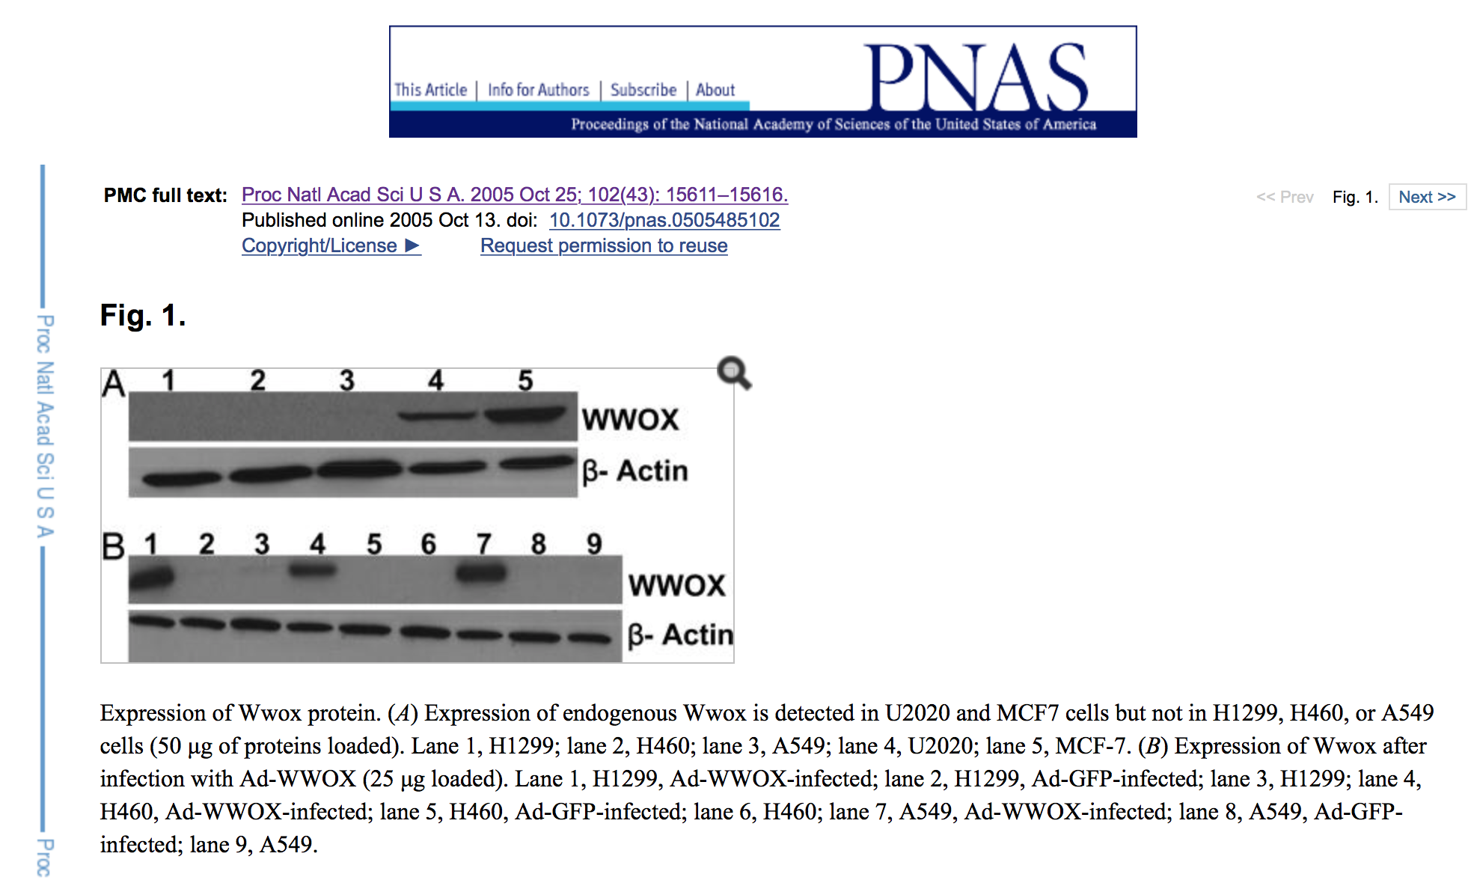
From the original paper Proc Natl Acad Sci U S A. 2005 Oct 25; 102(43): 15611–15616.

Slide 21
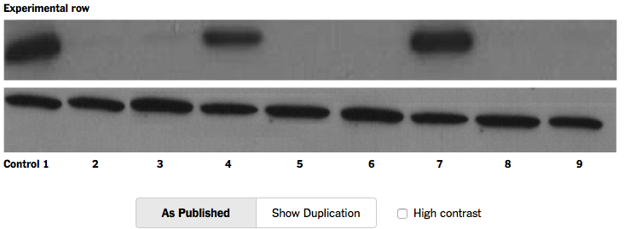
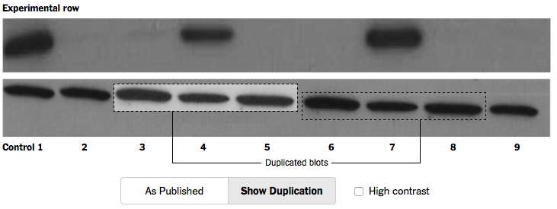
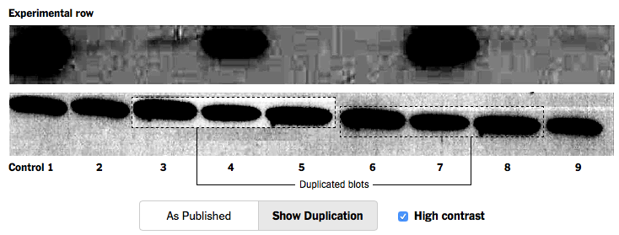

Slide 22
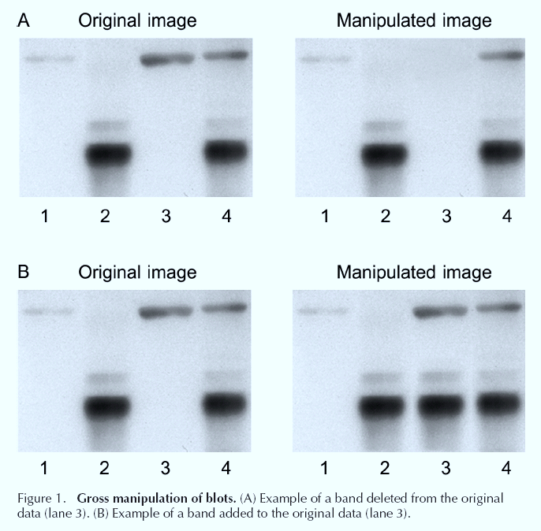
Ref: The Journal of Cell Biology Volume 166, Number 1, 2004

Slide 23
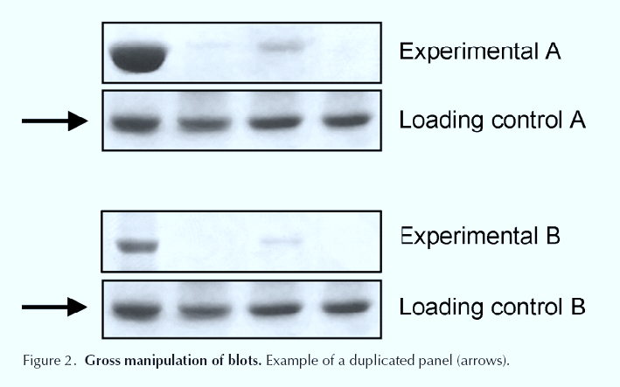
Real examples of fraud
Ref: The Journal of Cell Biology Volume 166, Number 1, 2004

Slide 24
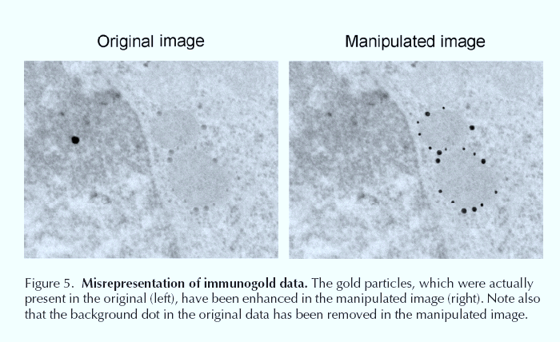
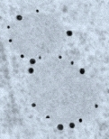
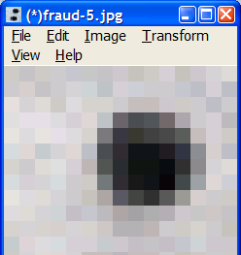
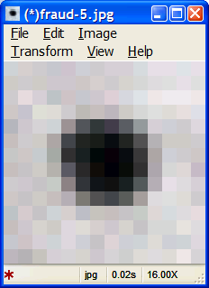
“You should be aware of the resolution at which the image was acquired by the digital camera on your microscope. When that file is opened in Photoshop, you have the option of setting the size and resolution of the image. You should not set the total number of pixels to be greater than that in the original image; otherwise, the computer must create data for you that were not present in the original, and the resulting image is a misrepresentation of the original data—that is, the dpi of an image can only be increased if the size of the image is reduced proportionately.”
Ref: The Journal of Cell Biology Volume 166, Number 1, 2004, p15

Slide 25
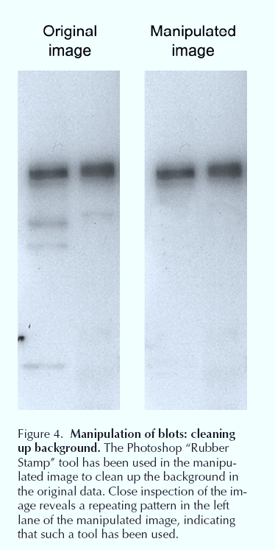
You cannot alter the background to suit….
Ref: The Journal of Cell Biology Volume 166, Number 1, 2004, p15

Slide 26
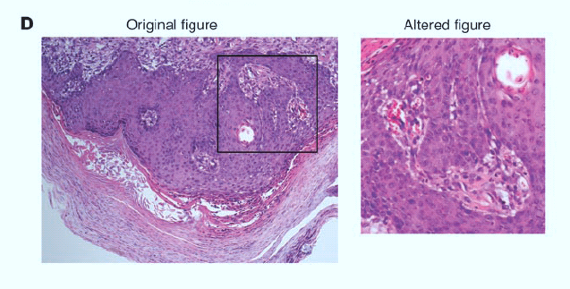
(C) The eraser tool was used to remove duplicate bands and background noise.
Image flipped and
color enhanced
(D) Authors have submitted subsections of previously published figures as original images, as in this hypothetical example. Note: The images have been intentionally manipulated for illustrative purposes.
The Journal of Clinical Investigation http://www.jci.org Volume 116 Number 7 July 2006

Slide 27
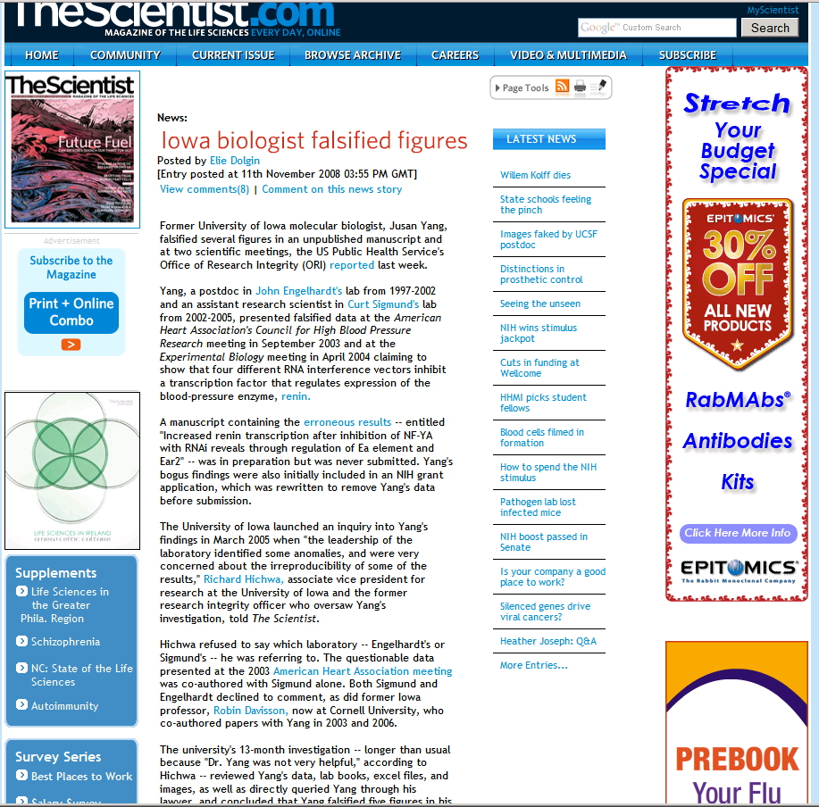

Slide 28
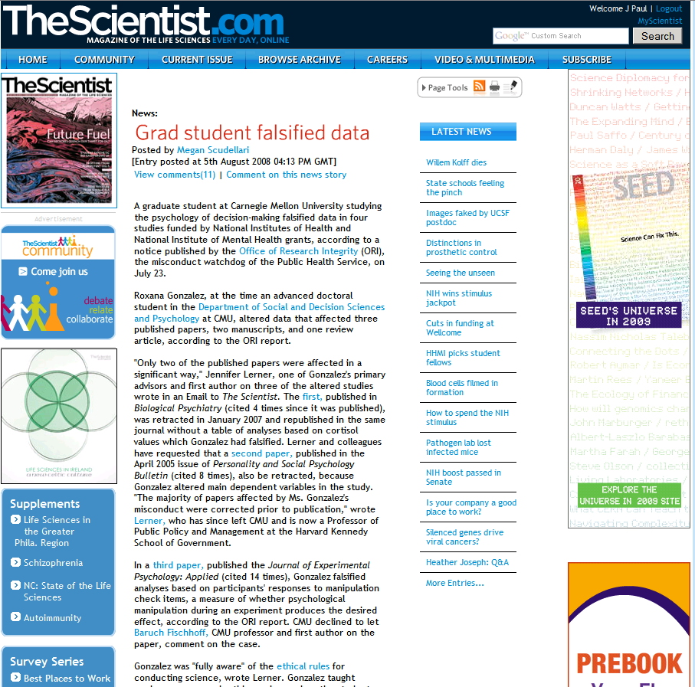

Slide 29
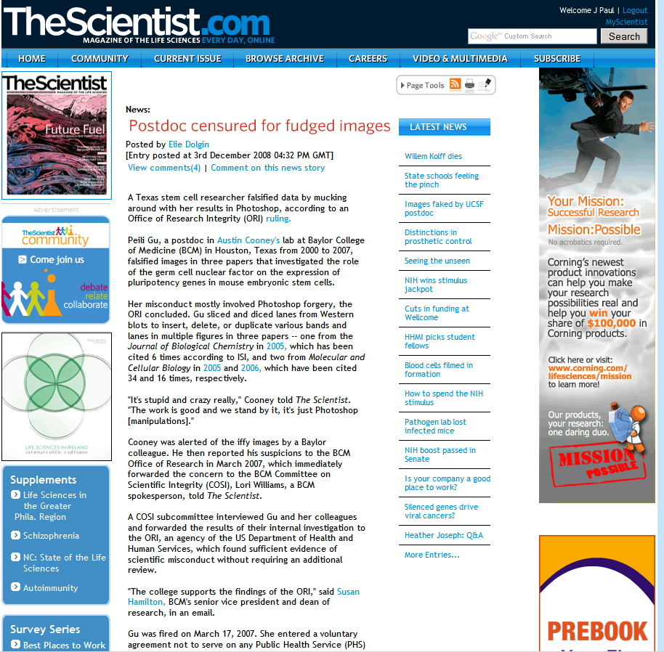

Slide 30
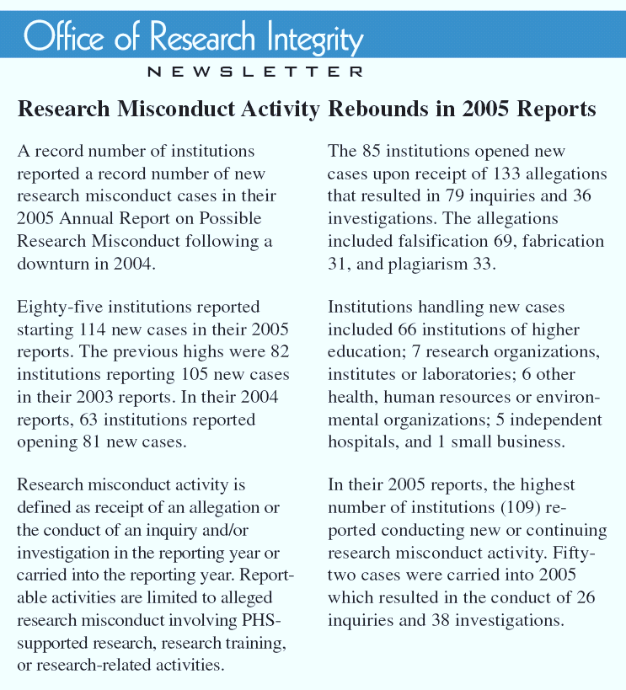

Slide 31
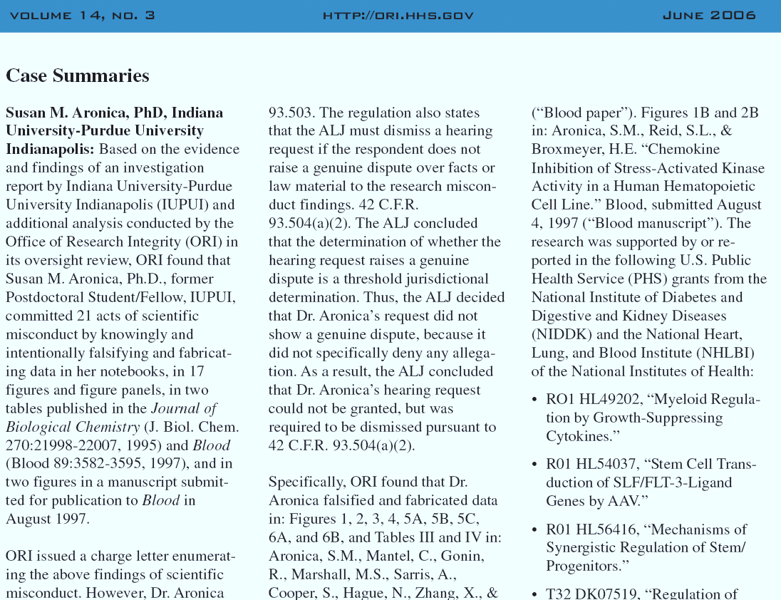
Susan M. Aronica

Slide 32
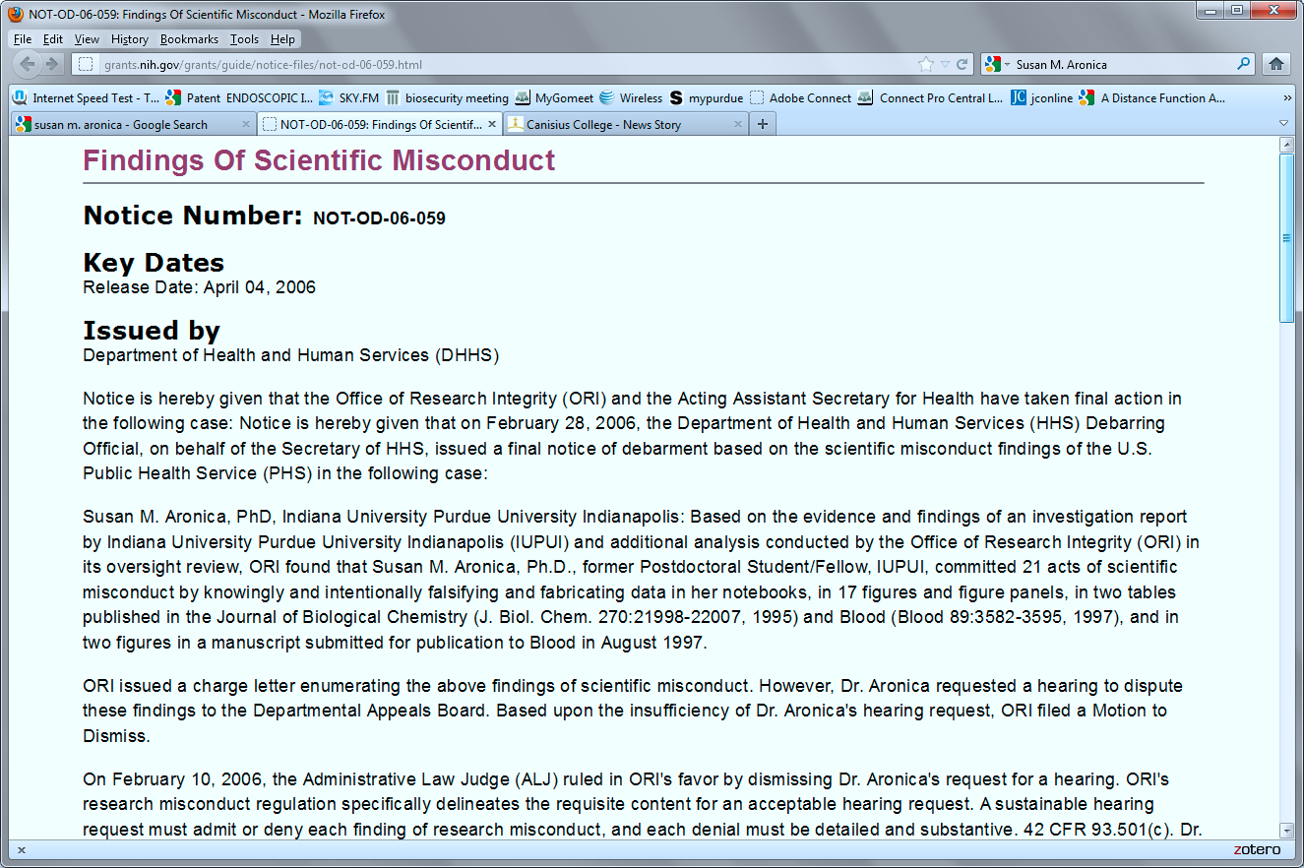

Slide 33
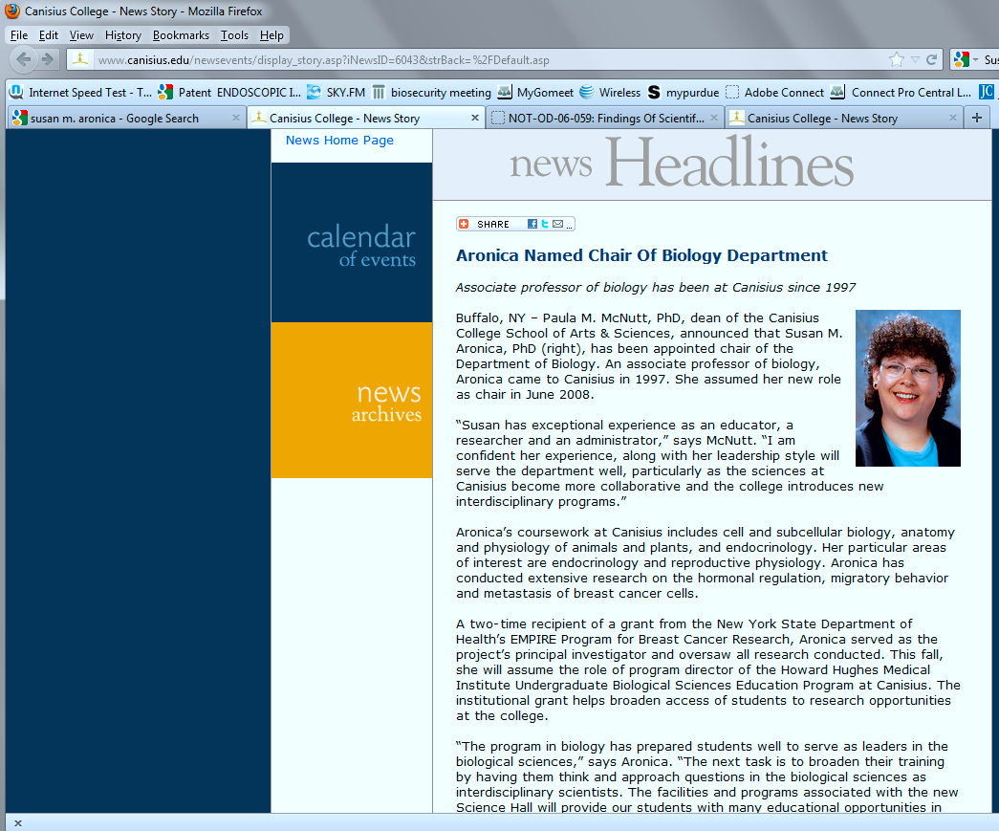

Slide 34
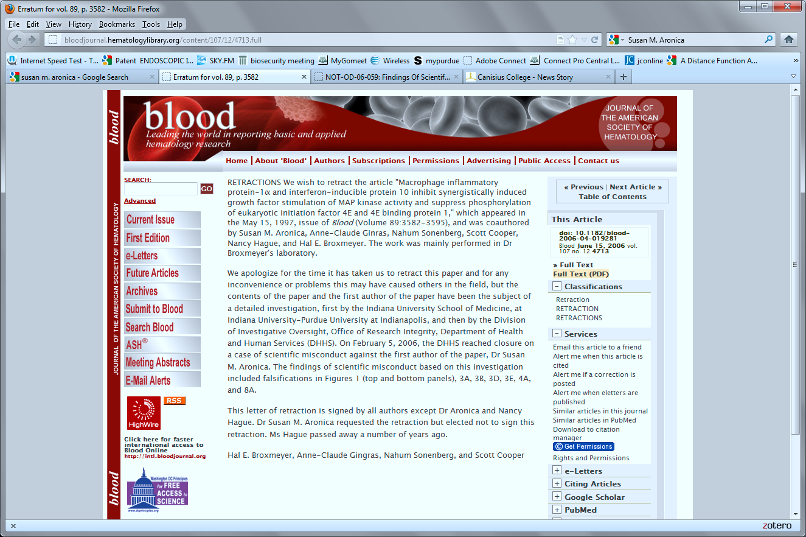

Slide 35
Case History
A Japanese virologist, Naoki Mori, has been dismissed from his job at the University of the Ryukyus in Nishihara, Okinawa, following numerous retractions due to problems with images, according to ScienceInsider.
Over the last year, Mori and co-authors had five papers retracted from the journal Infection and Immunity, three from the Journal of Virology, two from Blood and one from Retrovirology. The initial retractions were reported in December on Retraction Watch.
Mori is appealing his dismissal, claiming the inaccuracies were confined to the images depicting control data and that the experimental data “were portrayed entirely accurately,” he told

Slide 36
Case History
University of Washington (UW) School of Medicine researcher Andrew Aprikyan was fired for misconduct after a seven year investigation stemming from errors identified in digital images of a paper he published in Blood.
Now, an off-campus UW blog says the UW Senate issued a report, accessible only by UW staff, saying that the administration violated Aprikyan’s rights to due process during the misconduct case.

Slide 37
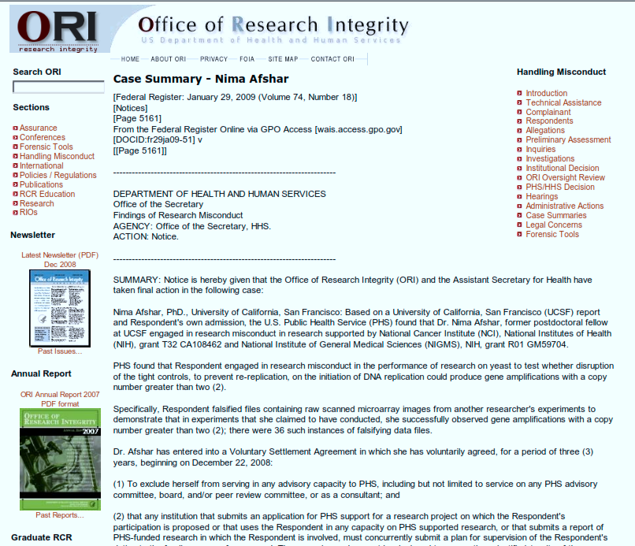

Slide 38
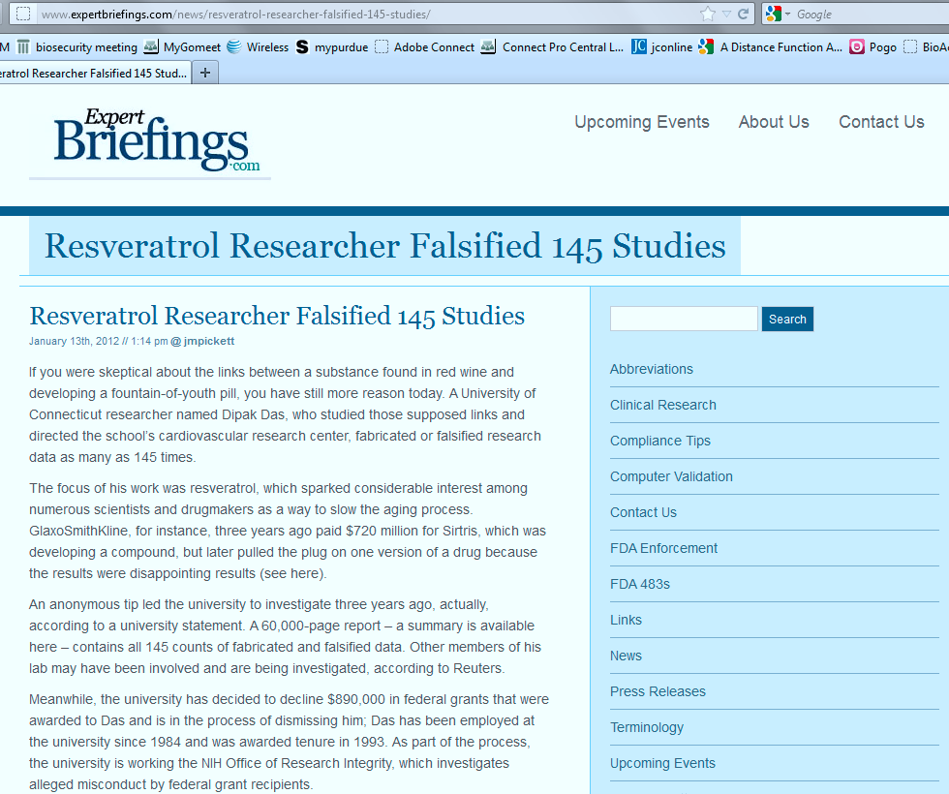

Slide 39
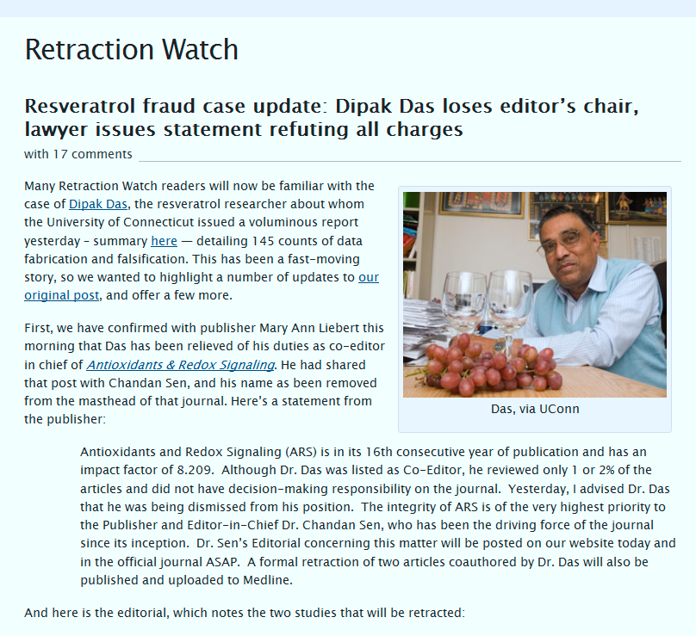
http://retractionwatch.wordpress.com/2012/01/12/resveratrol-fraud-case-update-dipak-das-loses-editors-chair-laywer-issues-statement-refuting-all-charges/

Slide 40
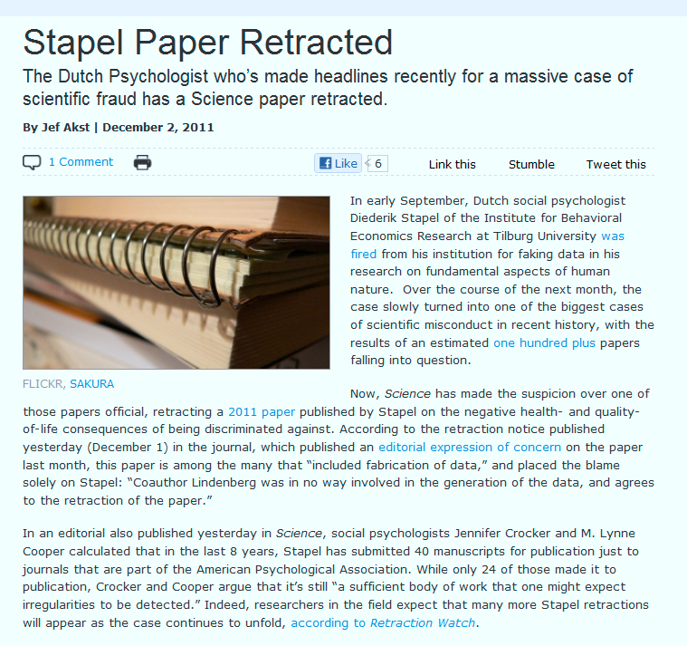
Diederik Stapel Fraud
http://the-scientist.com/2011/12/02/stapel-paper-retracted/

Slide 41
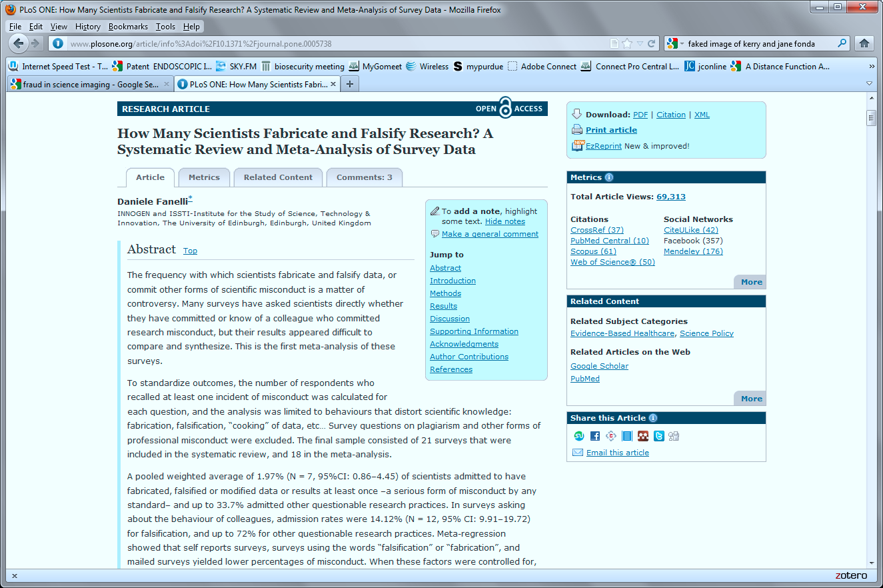

Slide 42
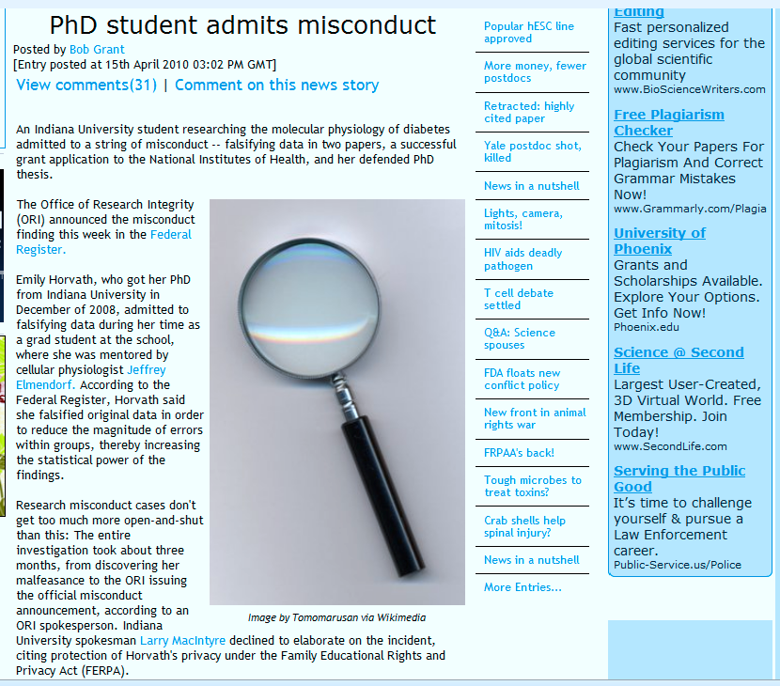
http://classic.the-scientist.com/blog/display/57297/

Slide 43
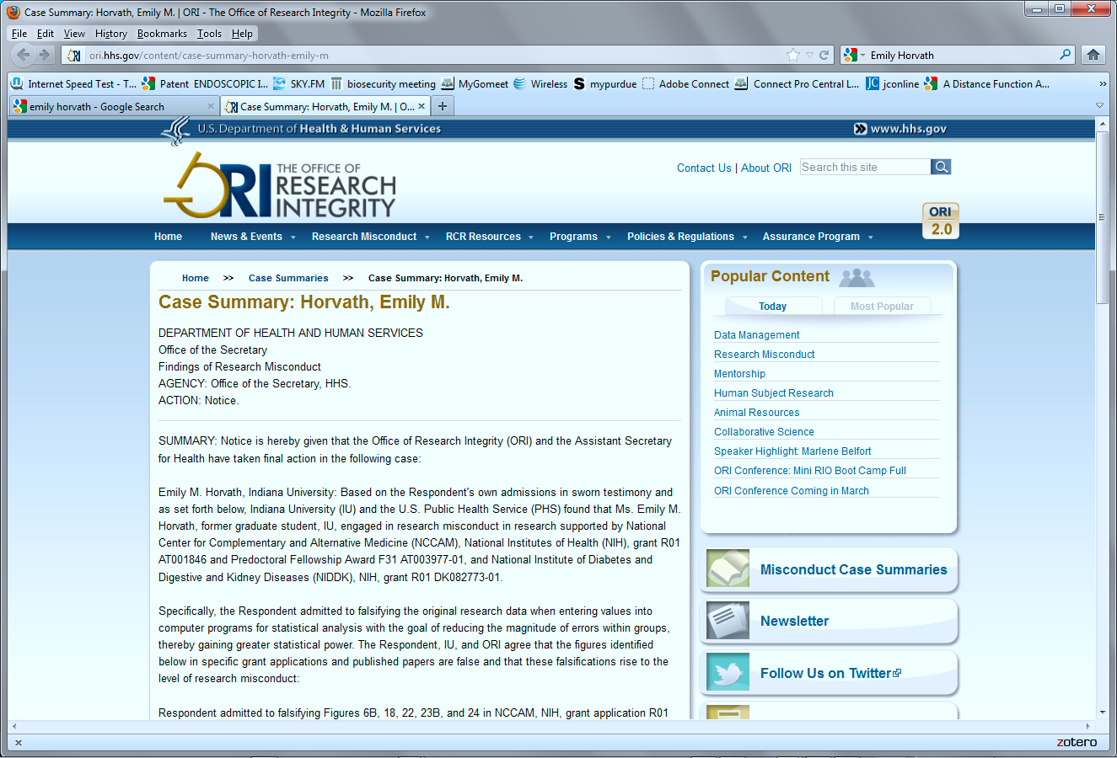

Slide 44
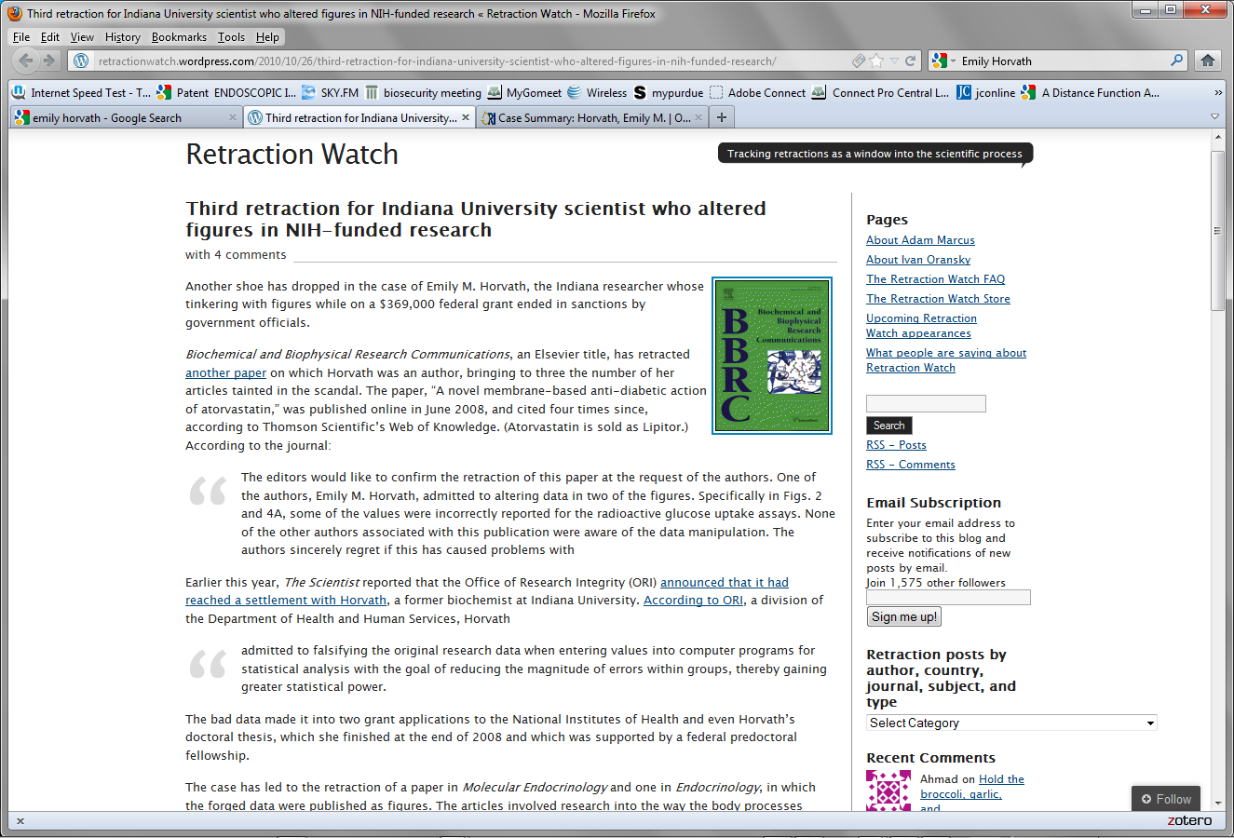

Slide 45
PhD Student falsifies data
Emily Horvath, who got her PhD from Indiana University in December of 2008, admitted to falsifying data during her time as a grad student at the school, where she was mentored by cellular physiologist Jeffrey Elmendorf.
According to the Federal Register, Horvath said she falsified original data in order to reduce the magnitude of errors within groups, thereby increasing the statistical power of the findings. Read more: PhD student admits misconduct - The Scientist - Magazine of the Life Sciences http://www.the-scientist.com/blog/display/57297/#ixzz1qPZFoTgM
According to the ORI, Horvath admitted to falsifying 5 figures in that grant application to the NIH's National Institute of Diabetes and Digestive and Kidney Diseases, which was awarded in March 2009.
She also admitted to falsifying 5 figures on a separate NIH grant application, on which Elmendorf was listed as the principal investigator, to the NIH's National Center for Complementary and Alternative Medicine. That application was withdrawn last May.
Read more: PhD student admits misconduct - The Scientist - Magazine of the Life Sciences http://www.the-scientist.com/blog/display/57297/#ixzz1qPZO5RSk

Slide 46
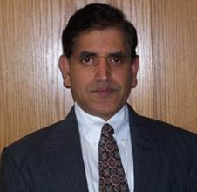
Tracking retractions as a window into the scientific process
University of Wisconsin neuroscientist faked data in two papers: ORI
Rao Adibhatla, via University of Wisconsin
A University of Wisconsin neuroscience researcher falsified “Western blot images as well as quantitative and statistical data” in two NIH-supported papers and three unfunded grant applications, the U.S. Office of Research Integrity (ORI) has found.
As first reported by the Milwaukee Journal-Sentinel and then The Scientist, Rao M. Adibhatla has agreed to retract the two papers, in the Journal of Biological Chemistry and Brain Research:
Adibhatla, R.M., Hatcher, J.F., Larsen E.C. et al. “CDP-choline Significantly Restores Phoshatidylcholine Levels by Differentially Affecting Phospholipase A2 and CTP:Phosphocholine Cytidylyltransferase after Stroke.” J. Biol. Chem. 281:6718-6725, 2006 (cited 65 times, according to Thomson Scientific’s Web of Knowledge)
Adibhatla, R.M., & Hatcher, J.F. “Secretory phospholipase A2 IIA is Up-regulated by TNF-[alpha] and IL-1[alpha]/[beta] after Transient Focal Cerebral Ischemia in Rat.” Brain Research 1134:199-205, 2007 (cited 36 times)
ORI found that Adibhatla
“committed research misconduct by falsifying Western blot images as well as quantitative and statistical data obtained from purported scans of the films. The research studied the effect of cerebral ischemia on phospholipid homeostasis in an experimental animal model (SHR rat) of stroke during the course of reperfusion of the ischemic cortex. The falsified Western blot images and derivative quantitative data describe changes in levels of sPLA2-IIAA, CCT[alpha], and of PLD2 during reperfusion in the ischemic cortex.”
http://retractionwatch.wordpress.com/2013/01/28/university-of-wisconsin-neuroscientist-faked-data-in-two-papers-ori/

Slide 47
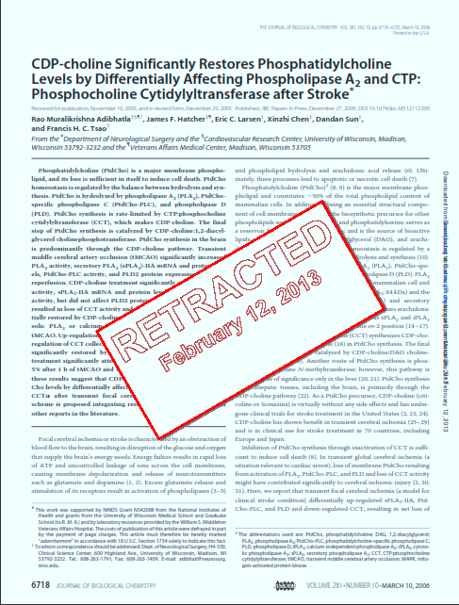

Slide 48
*Falsified and/or fabricated images in NIH grant application R01 HL078976-01A1 by duplicating and altering bands in 14 Western blot images and one (1) RT-PCR image included in Figures 3, 6, 11, 12, 13, 14, and 15; false Western blots were also included in the earlier version of the grant application R01 HL078976-01, Figures 3, 6, 11, 13, and 14
*Falsified and/or fabricated Western blots and one (1) RNase protection assay by duplicating and altering bands in thirty-three (33) figures included in ten (10) published papers, one (1) submitted manuscript, and two (2) NIH grant applications.
http://retractionwatch.wordpress.com/2012/11/20/ori-sanctions-university-of-kentucky-nutrition-researcher-for-faking-dozens-of-images-in-10-papers/

Slide 49
…”But zooming in on two blots from one figure in a 2002 paper (pictured at right) from the Journal of Biological Chemstry, volume 277, pages 4925-31, reveals tell-tale noise patterns that may well betray the images’ common origin.”
http://blogs.nature.com/news/2012/11/nutrition-researcher-censured-over-serial-misconduct.html

Slide 50
Just a few of the links on my computer

Slide 51
The latest “trick” used by sneaky scientists…Reviewing their own papers by creating fake emails addresses....

Slide 52
University of Chicago

Slide 53
ARTICLE FROM JUN 9 2016

Slide 54
July 12, 2016

Slide 55
June 2, 2016

Slide 58
2016
Meredyth M. Forbes, Albert Einstein College of Medicine
Andrew R. Cullinane, Ph.D., National Institutes of Health
Karen M. D’Souza, Ph.D., University of Chicago
Zhiyu Li Ph.D., Mount Sinai School of Medicine
Ricky Malhotra, Ph.D., University of Michigan and University of Chicago
John G. Pastorino, Ph.D., Rowan Univ School of Osteopathic Medicine
Kenneth Walker, Ph.D., University of Pittsburgh

Slide 59
2015
David Anderson, University of Oregon, Eugene: Graduate Student
Ryan Asherin, Oregon Health Authority: Principal Investigator
Julia Bitzegeio, Ph.D., Aaron Diamond AIDS Research Center: PD
Brandi Blaylock, Wake Forest School of Medicine: Graduate Student
Teresita L. Briones, Ph.D., Wayne State University: Assoc Prof
Girija Dasmahapatra, Ph.D., Virginia Commonwealth Univ: Instructor
Ryousuke Fujita, Ph.D., Columbia University: Post Doc
Dr. Maria C.P. Geraedts, University of Maryland, Baltimore: PD
Bin Kang, Ph.D., Oklahoma Medical Research Foundation: PD
Peter Littlefield, University of California, San Francisco: Grad Student
Julie Massè, Pennsylvania State University (PSU):Post Doc
Anil Potti, M.D., Duke University School of Medicine: Assoc Prof
Venkata J. Reddy, University of Minnesota: Grad Student
Dong Xiao, Ph.D., University of Pittsburgh: Assist Prof

Slide 60
From Retraction Watch http://retractionwatch.com

Slide 61
https://ori.hhs.gov/droplets Photoshop “droplets”
Histogram Equalization, which may reveal areas of erasure in dark areas, or areas of whitening in bright areas.
Forensic details in the background on in fine structure surrounding the features in question may be used to visualize evidence to assess whether two features are the same. non-linear contrast adjust and amplify differences False coloring facilitates detection of small differences in gray shades that would be otherwise imperceptible.
Details in images with which contrast or steep spatial gradients (small features) will be better revealed using LUT's with fewer cycles in contrast or color.

Slide 62
Methods
On-Line Journal Image:
Visualize with Gradient Map:
Remap Intensities
Add False-Color

Slide 63
Retraction Watch
You may not even know your name is on a paper!!!
http://retractionwatch.com/2017/04/10/researcher-gave-fake-contact-info-co-authors-submit-papers-without-consent/

Slide 64
Retraction Watch
http://retractionwatch.com/2017/04/10/researcher-gave-fake-contact-info-co-authors-submit-papers-without-consent/

Slide 65
100+ Papers withdrawn for fake reviews http://retractionwatch.com/category/by-reason-for-retraction/self-peer-review/

Slide 66
Journal starting to evaluate images http://retractionwatch.com/2017/04/21/job-alert-biology-society-hiring-editors-screen-images/

Slide 67
What Journals themselves might not be scientifically acceptable?
SCOPUS, the publication database maintained by Elsevier, has discontinued nearly 300 journals since 2013, including multiple journals published by OMICS Publishing Group.
See the link from Retraction Watch here
http://retractionwatch.com/2017/03/27/multiple-omics-journals-delisted-major-index-concerns/
Here is a listing of over 300 journals now considered to be “junk” science –many OMICS journals and others that “publish for money”!
https://www.elsevier.com/__data/assets/excel_doc/0019/212275/Discontinued-sources-from-Scopus_Feb2017.xlsx

Slide 68
The Scientist, Dec 27, 2018
From a self-sampling scientist to the downfall of a leading stem cell scientist, here’s our naughty
ABOVE: Kim Kardashian's name appeared as an author on a now-retracted fake paper.
Kim Kardashian ???
Yoshitaka Fujii with 183 retractions, and it now takes at least 21 retractions to crack the Top 30
A pair of nanotech researchers in India have now lost at least two dozen papers each for image manipulation and questions about their data. The retractions landed Rashmi Madhuri (24) and Prashant Sharma (26) on our leaderboard this year

Slide 69
Manipulating Images for publication?
…we might teach you how to manipulate scientific images…
….But we also know how others can determine if you cheated!!....

Slide 70
Conclusion & Summary
Your responsibility:
Review the rules before you manipulate images you are going to publish
Manipulate images legally
Manipulate controls and test images identically
Do not think you can reduce backgrounds in controls and not test images
Document the processes you use to manipulate images
Consequences of failure to above
It is getting easier to determine when someone has cheated in imaging
If (when) you are caught doing illegal manipulations, you will be publically sanctioned
Your name will be forever on the web and publically disgraced
Your institution will be reflected poorly
Your professor and department will also be identifed

